Slide 1
Strategies To Avoid Communication Breakdown
Presented by: Lauren Rugless

Slide 2
Objectives
Define communication and discuss the standards of effective communication
Describe the importance of communication and consider goals of communication
Discuss the significance of clinical skill
Recognize the connection between communication and medical error
Improve patient safety by understanding barriers and establish tools for positive outcomes
Describe strategies to improve patient safety and be able to practice SBAR

Slide 3
Defining Communication
_________________________________________
Communication is the exchange of information, ideas or opinions among individuals, departments and organizations through verbal and nonverbal methods. _________________________________________

Slide 4
Standards of Effective Communication
Complete: Communicate all relevant information
Clear: Convey information that is plainly understood, When you don’t know what to say, say nothing.
Brief: Speak briefly and focus on the listener’s feelings and nonverbal cues
Timely:
Offer and request information in an appropriate timeframe
Verify authenticity
Validate or acknowledge information

Slide 5
Importance of Effective Communication
Effective communication skills are not only a requirement for a successful nurse, but they also foster a collaborative environment.
The ability to communicate and connect with patients, their families and healthcare professionals is a key factor in building relationships, establishing trust, preventing mistakes and providing a higher level of care.

Slide 6
Communication Goals among new nurses
Communicate goals of care effectively
Build rapport with patients and colleagues
Ability to advocate for patients effectively
Enhance active listening skills
Develop empathy in communication
Gain from respect and trust from patients and colleagues
Enhance assertiveness in communication
Improve clarity and conciseness in communication
Cultivate effective communication in stressful situations
Become a proficient and confident communicator

Slide 7
Clinical Skill
“People will forget what you said, People will forget what you did, But people will never forget how you made them feel.”
Dr. Maya Angelou, poet and civil rights activist

Slide 8
Clinical Skill & Nonverbal Communication
Timing
Eye Contact
Proximity
Pauses

Slide 9
Clinical Skill & Cultural Considerations
Culture is not genetic. It is far more than race or ethnicity. Culture describes large groups of people classed according to:
You learn culture from who you grew up with and where you grew up. It is passed on from one generation to the next through systems of:
Race
Nationality
Tribe
Religion
Linguistics
Cultural origin
Background
Attitudes
Beliefs
Fears
Learned behaviors
Values
Practicing cultural respect makes sure care is sensitive and appropriate to the person.
(National Institutes of Health, 2021).

Slide 10
Communication and Medical Errors
_________________
A study published in the International Brazilian Journal of Medicine found a prevalence of 42.8% of medical errors among medical practitioners in Abia State, Nigeria
__________________
Causes of Medical Errors in Nigeria:
Limited Resources: Understaffing, lack of proper equipment or protection, inadequate care
Poor Record Keeping: Paper-based medical records are prone to inaccuracies and can lead to confusion.
Communication Issues: Miscommunication between healthcare providers can be a significant factor.
Culture of Silence: A reluctance to disclose errors due to fear of repercussions can hinder improvement efforts.
Reflection: In what ways can your training as a nursing student help you avoid medical errors?

Slide 11
Rights of Medication Administration

Slide 12
Communication Barriers among new nurses
Difficulty conveying complex medical information clearly
Feeling overwhelmed during handovers or with patient volume
Struggle to assert themselves to multidisciplinary teams
Inability to delegate for fear of retaliation
Feeling anxious during difficult conversations with patients or families
Handling aggressive or hostile behavior from patients or families
Dealing with language barriers with patients or colleagues
Fear of being unable to handle emergencies effectively
Feeling disrespected by preceptors or peers

Slide 13
Communication Barriers with other nurses

Slide 14
Communication Barriers with patients
Arguing, minimizing, challenging
Giving false reassurances
Interpreting or speculating on the dynamics of the patient’s problems
Probing sensitive areas
“Selling” the patient on accepting treatment
Participating in criticism of any staff member
Joining any attacks led by the patient

Slide 15
Preventing Nurse Burnout
Implement emotional intelligence training for nurses
Enhances empathy and understanding
Improves nurse-team relationships
Establish regular debriefing sessions for nurses
Provides a place of safety for reflection
Enhances team cohesion and resilience
Introduce mental health resources and counseling services for nurses
Support for mental well-being aids in coping with stress and reduces risk for burnout
Strategies To Avoid Communication Breakdown

Slide 16
Improving Patient Safety Through Communication
Barriers
Information Exchange Strategies
Outcomes
Cultural and language barrier
Distractions
Physical proximity
Personalities
Workload
Fatigue
Varying communication styles
Conflict
Lack of information verification
Lack of time
Hierarchy
Shift change
Lack of Coordination and follow-up with co-workers
Inadequate training
Lack of resources
Call-Out
Closed-Loop
SBAR
Handoff
Brief
Huddle
Debrief
STEP
Cross-Monitoring
Feedback
Advocacy and Assertion
Two-Challenge Rule
CUS
DESC Script
Collaboration
Better relationships
Improved productivity
Innovation
Adaptability
Fewer conflicts
Accuracy
Mutual Trust
Collaboration
Patient Safety

Slide 17
Call-Out
A strategy used to verbalize actions/task
The team leader informs all team members simultaneously during emergencies
The team leaders speaks in a clear, concise and even tone that helps team members anticipate next steps

Slide 18
Closed-Loop
The team leader speaks in steps to communicate to the team during an emergency response. Team members assume responsibility for a specific role.
The team leader gives a message, order, or assignment to a team member
By receiving a clear response and eye contact, the team leader confirms that the team member heard and understood the message
The team leader listens for confirmation of task performance from the team before assigning another task.
Example:
Physician: “Could you give methergine, 0.2 mg IM, now, please?”
Nurse: “I'll get methergine, 0.2 mg IM, to give immediately.”

Slide 19
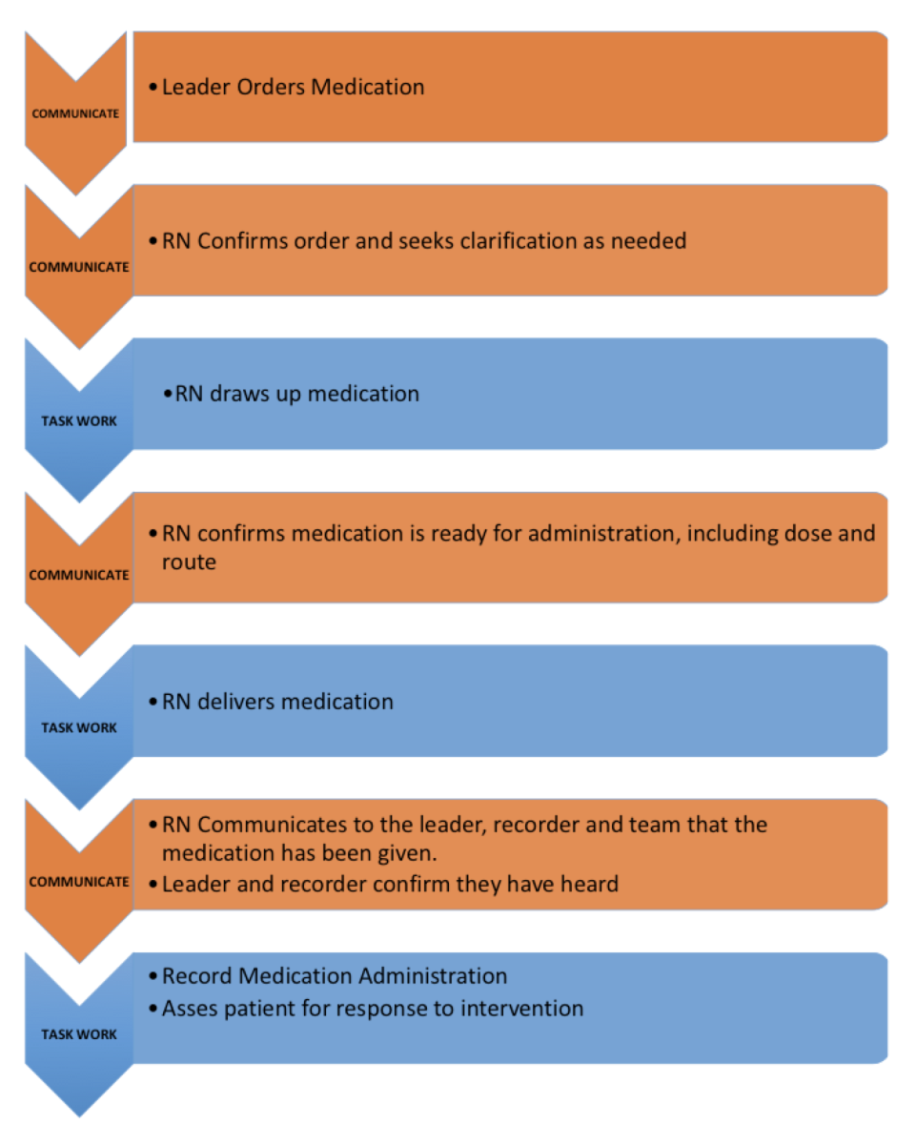
Reflection: How do you ensure that the message you intended to deliver was the message that was understood by the individual who received it?

Slide 20
Situation–Background–Assessment-Recommendation
A crucial framework that enables team members to effectively communicate information to one another, ensuring safe and effective patient care.
Situation―What is going on with the patient?
Background―What is the clinical background or context?
Assessment―What do I think the problem is?
Recommendation―What would I recommend?

Slide 21
Create an SBAR based on your role
Scenario:
Example:
Admitted to: Cardiac PCU
Diagnosis: cardiomyopathy
Developed: Difficulty breathing and elevated blood pressure
Why notifying: Status changed, limited medications, and may need further testing
Situation – What is happening?
“Hello Dr. _____
Identify yourself and unit
State patients name and room number
Reason for calling
Background – What is the background?
Nurse should have thoroughly reviewed the patients chart and should be knowledgeable about their lab results, medications assessments, diagnosis, code status, consults, procedures and admission date
Provide a brief description of what has changed up until this point.
Assessment – What do I think the problem is?
Provide current vital signs
Respiratory, cardiac, neuro issue?
Don’t know? Say “worried, unstable, deteriorating, changed”
Recommendation – What would I recommend?
More orders or clarification? (labs, test, medications, restraints, etc.)
See the patient
Their recommendations

Slide 22
Handoff
The exchange of information between healthcare professionals about a patient accompanying a transfer (along with authority and responsibility) for safe and effective patient care.
It includes an opportunity to ask questions, clarify, review and confirm information at the patients bedside.

Slide 23
Handoff Example
Introduction: Introduce yourself and your role/job (include provider)
Patient: Identifiers, age, sex, location
Assessment: Relevant diagnoses and complaints, vital signs and symptoms
Situation: Current status (e.g., ADL status, intake, elimination, behavior, cognition), including code status, level of uncertainty, recent changes, and response to treatment
Safety: Critical lab values/reports, allergies, and alerts (falls, isolation, etc.)
Background: Other diagnoses, previous episodes, current medications, history
Actions: What actions were taken or are required? Provide brief rationale
Timing: Level of urgency and explicit timing and prioritization of actions
Ownership: Who is responsible (nurse/doctor/APRN/nursing assistant)? Include patient/family responsibilities
Next: What will happen next? Anticipated changes? Are there contingency plans

Slide 24
Summary
Essential information is communicated through the team leader
Be clear and concise when communicating
Utilize Call-Out to verbalize actions and task
Ensure the Loop is closed when communicating
Handoffs are organized and effective
Seek information from all available sources
Verify and share information

Slide 25
Communication Super Word

Slide 26
DON’T GIVE UP!
“Nursing school is a lot like giving birth….once its over, you just tend to forget how painful the process really was.” Unknown
Strategies To Avoid Communication Breakdown

Slide 27
Thank you!
Lauren Rugless, RN, BSN, MBA
Lets connect
linkedin.com/in/laurenrugless/

Slide 28
References and Resources
https://qualitysafety.bmj.com/content/30/10/782
https://www.ncbi.nlm.nih.gov/pmc/articles/PMC8318178/
https://pubmed.ncbi.nlm.nih.gov/27567765/
https://www.sciencedirect.com/science/article/abs/pii/S147159532300032X
https://www.who.int/news-room/fact-sheets/detail/patient-safety#:~:text=Key%20facts,from%20unsafe%20care%20(1)
http://formatcomunicacion.com/VerbalAndNonverbal/verbal-and-nonverbal-communication-in-nursing
https://www.aha.org/center/project-firstline/teamstepps-video-toolkit/closed-loop-communication#:~:text=In%20closed%2Dloop%20communication%2C%20the,is%20likely%20to%20save%20time
https://www.rasmussen.edu/degrees/nursing/blog/bullying-in-nursing-nurses-eat-their-young/
https://nurseslabs.com/10-rs-rights-of-drug-administration/#google_vignette
https://www.linkedin.com/advice/3/youre-struggling-keep-up-your-workload-how-can-you-stay-h5r0f
https://www.semanticscholar.org/paper/Medication-Prescribing-Errors-In-A-Tertiary-In-and-Ajemigbitse-Omole/81eaa21863be6a069999305a200e0c9e9b58f287
Medical errors in Nigeria: A cross-sectional study of medical practitioners in Abia State (https://www.researchgate.net/publication/315677910_Medical_errors_in_Nigeria_A_cross-sectional_study_of_medical_practitioners_in_Abia_State) by I. A. Ikpo et al. (2017).

